Slide 1
Acids & Bases

Slide 2
Acids & Bases
What do you know about them?

Slide 3
Historical Models of Acids & Bases
Boyle (1660s):
Used litmus to classify acids and bases.
Defined their characteristic properties.
Acids | Bases (Alkalies)
Sour taste | Feel slippery
Corrosive
Turns blue litmus red | Turns red litmus blue
Becomes less acidic when combined with bases | Becomes less alkaline when combined with acids

Slide 4
Historical Models of Acids & Bases
Lavoisier (1770s):
Studied combustion of carbon, sulfur, phosphorous and nitrogen
Products of combustion showed acidic properties
Concluded that acidity is caused by oxygen

Slide 5
Historical Models of Acids & Bases
Davy (1810s):
Discovered the element chlorine
Showed that the substance ‘oxymuriatic acid’ (now called hydrochloric acid) didn’t contain oxygen
This contradicted previous model of acids & bases. Davy instead proposed acids contain hydrogen.
Von Liebig extended Davy’s theory by defining acids as substances that contain replaceable hydrogen (hydrogen that can be replaced by metals)
e.g. 2 HCℓ + Zn → ZnCℓ₂ + H₂

Slide 6
Historical Models of Acids & Bases
Limitations of Davy’s model:
Does not explain why some substances containing H (e.g. HCℓ) are acidic but others (CH₄) are not

Slide 7
Arrhenius theory
Main principles:
Acids produce H⁺ ions when dissolved in water
Bases produce OH⁻ ions when dissolved in water
Acids and bases neutralise each other: H⁺(aq) + OH⁻(aq) → H₂O(ℓ)
Ionisation / Dissociation equations
Ionisation refers to a covalent molecular substance forming ions
HCℓ(aq) → H⁺(aq) + Cℓ⁻(aq)
CH₃COOH(aq) ⇌ CH₃COO⁻(aq) + H⁺(aq)
Dissociation refers to the separation of ions from an ionic substance when dissolved in water
NaOH(s) → Na⁺(aq) + OH⁻(aq)
Ba(OH)₂(s) → Ba²⁺(aq) + 2 OH⁻(aq)

Slide 8
Arrhenius theory
Monoprotic acids:
Only contain one ionisable hydrogen atom Examples: HCℓ, HNO₃, CH₃COOH
Polyprotic acids:
Contain multiple ionisable hydrogen atom Diprotic: H₂SO₄, H₂CO₃ Triprotic: H₃PO₄
Each ionisation step can be shown separately… (successive ionisation)
H₃PO₄(aq) ⇌ H⁺(aq) + H₂PO₄⁻(aq)
H₂PO₄⁻(aq) ⇌ H⁺(aq) + HPO₄²⁻(aq)
HPO₄²⁻(aq) ⇌ H⁺(aq) + PO₄³⁻(aq)
…or summarised into a single equation
H₃PO₄(aq) ⇌ 3 H⁺(aq) + PO₄³⁻(aq)

Slide 9
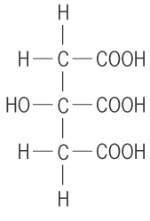
Arrhenius theory
Citric acid (C₆H₈O₇) is a weak, triprotic acid. Write a successive ionisation equations for citric acid.
C₆H₈O₇(aq) ⇌ C₆H₇O₇⁻(aq) + H⁺(aq)
C₆H₇O₇⁻(aq) ⇌ C₆H₆O₇²⁻(aq) + H⁺(aq)
C₆H₆O₇²⁻(aq) ⇌ C₆H₅O₇³⁻(aq) + H⁺(aq)

Slide 10
Monoprotic & Polyprotic acids
Affects how many moles of acid are needed to neutralise a base.
Equation Moles acid Moles base needed
HCℓ + NaOH → NaCℓ + H₂O 1.00 mol 1.00 mol
H₂SO₄ + 2 NaOH → Na₂SO₄ + 2 H₂O 1.00 mol 2.00 mol
H₃PO₄ + 3 NaOH → Na₃PO₄ + 3 H₂O 1.00 mol 3.00 mol
If you were provided with 1 mol L⁻¹ of an acid, and had to determine whether it is monoprotic or polyprotic, what could you do experimentally? What other chemicals and equipment would you need?

Slide 11
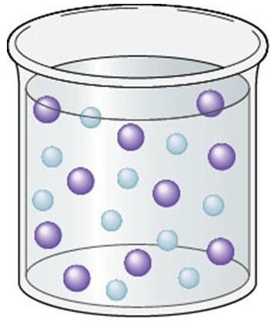
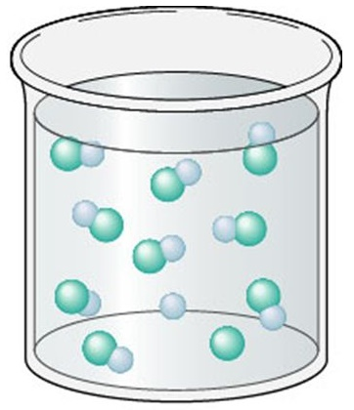
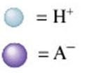


Strong vs Weak
Strong acids fully ionise in solution.
Weak acids only partially ionise in solution. They exist in equilibrium with molecules.
Example:
HA is a strong acid… HB is a weak acid… HA(aq) → H⁺(aq) + A⁻(aq) HB(aq) ⇌ H⁺(aq) + B⁻(aq)

Slide 12
Strong vs Weak
Common acids:
Strong acids |  | Weak acids
Hydrochloric acid | HCℓ | Ethanoic acid | CH₃COOH
Nitric acid | HNO₃ | Carbonic acid | H₂CO₃
Sulfuric acid * | H₂SO₄ | Phosphoric acid | H₃PO₄
 |  | Hydrofluoric acid | HF
 |  | Sulfurous acid | H₂SO₃
* Note: Only the first ionisation of sulfuric acid is strong. The second ionisation is weak.
H₂SO₄(aq) → H⁺(aq) + HSO₄⁻(aq)
HSO₄⁻(aq) ⇌ H⁺(aq) + SO₄²⁻(aq)

Slide 13
Strong vs Weak
Common bases:
Strong bases |  | Weak bases
Metal hydroxides. e.g. | NaOH | Ammonia | NH₃
 | KOH | Methylamine | CH₃NH₂
 | Ba(OH)₂ | Carbonate ion | CO₃²⁻

Slide 14
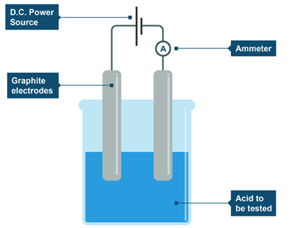
Evidence of Arrhenius Theory
Conductivity:
Solutions can be classified as:
Strong electrolytes (conduct electricity well)
Weak electrolytes (conduct electricity poorly)
Non-electrolytes (do not conduct electricity)
Conduction of electricity is related to presence of mobile charged particles (e.g. individual ions)
All solutions of acids and bases conduct electricity, ∴ all solutions of acids and bases contain free ions

Slide 15
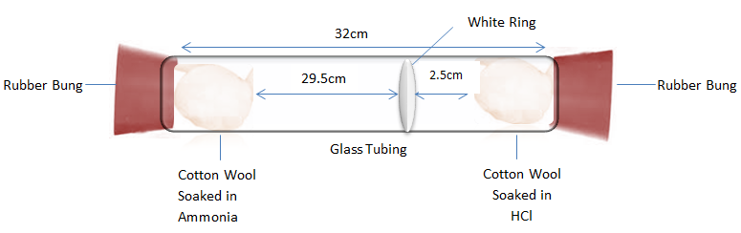
Problems with Arrhenius theory
*
Some substances such as ammonia (NH₃) and sodium carbonate (Na₂CO₃) were known to be basic, but didn’t contain OH in their formula.
Some scientists argued that Arrhenius theory was still valid, because these substances could react with water to form OH⁻ ions.
NH₃(aq) + H₂O(ℓ) ⇌ NH₄⁺(aq) + OH⁻(aq)
CO₃²⁻(aq) + H₂O(ℓ) ⇌ HCO₃⁻(aq) + OH⁻(aq)
However, pure gaseous ammonia reacts with HCℓ even when there is no water present.
NH₃(g) + HCℓ(g) → NH₄Cℓ(s)

Slide 16
Problems with Arrhenius theory
*
According to Arrhenius theory, acids and bases should produce neutral solutions, because the H⁺ ions will react with the OH⁻ ions to produce water.
e.g. HCℓ(aq) + NaOH(aq) → NaCℓ(aq) + H₂O(ℓ) NaCℓ(aq) is neutral ✓
However some acid-base reactions produce basic solutions
e.g. CH₃COOH(aq) + NaOH(aq) → NaCH₃COO(aq) + H₂O(ℓ) NaCH₃COO(aq) is basic, not neutral
And some acid-base reactions produce acidic solutions
e.g. HCℓ(aq) + NH₃(aq) → NH₄Cℓ(aq) NH₄Cℓ(aq) is acidic, not neutral

Slide 17
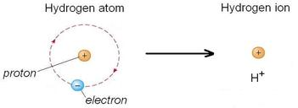
Problems with Arrhenius theory
*
H⁺ represents an individual proton.
In reality, H⁺(aq) would be too unstable to exist in solution for significant amounts of time. It would quickly react with water to form hydronium ion (H₃O⁺).
H⁺(aq) + H₂O(ℓ) → H₃O⁺(aq)

Slide 18
Brønsted-Lowry Theory
Definitions:
Acids are substances that donate one or more protons (‘proton donors’)
Bases are substances that accept one or more protons (‘proton acceptors’)
H
–
+
N
H
Cℓ
+
H
H

Slide 19
Brønsted-Lowry Theory
Definitions:
Acids are substances that donate one or more protons (‘proton donors’)
Bases are substances that accept one or more protons (‘proton acceptors’)
H
+
H
–
N
H
N
H
Cℓ
+
Cℓ
+
H
H
H
H
HCℓ donates a proton
∴ HCℓ acts as an acid
NH₃ accepts a proton
∴ NH₃ acts as a base

Slide 20
Brønsted-Lowry Theory
Definitions:
Acids are substances that donate one or more protons (‘proton donors’)
Bases are substances that accept one or more protons (‘proton acceptors’)
H
–
–
Cℓ
+
O
H

Slide 21
Brønsted-Lowry Theory
Definitions:
Acids are substances that donate one or more protons (‘proton donors’)
Bases are substances that accept one or more protons (‘proton acceptors’)
H
–
–
H
+
O
+
O
Cℓ
Cℓ
H
H
HCℓ donates a proton
∴ HCℓ acts as an acid
OH⁻ accepts a proton
∴ OH⁻ acts as a base

Slide 22
Brønsted-Lowry Theory
Acids and bases in aqueous solutions:
Brønsted-Lowry theory also applies to acids and bases dissolving in water to form an aqueous solution. Water will either accept to proton to form H₃O⁺(aq) or donate a proton to form OH⁻(aq).
H
–
+
Cℓ
+
O
H
H

Slide 23
Brønsted-Lowry Theory
Acids and bases in aqueous solutions:
Brønsted-Lowry theory also applies to acids and bases dissolving in water to form an aqueous solution. Water will either accept to proton to form H₃O⁺(aq) or donate a proton to form OH⁻(aq).
H
–
H
+
+
O
+
O
Cℓ
Cℓ
H
H
H
H
HCℓ donates a proton
∴ HCℓ acts as an acid
H₂O accepts a proton
∴ H₂O acts as a base

Slide 24
Brønsted-Lowry Theory
Acids and bases in aqueous solutions:
Brønsted-Lowry theory also applies to acids and bases dissolving in water to form an aqueous solution. Water will either accept to proton to form H₃O⁺(aq) or donate a proton to form OH⁻(aq).
+
H
-
H
+
O
N
H
H
H

Slide 25
Brønsted-Lowry Theory
Acids and bases in aqueous solutions:
Brønsted-Lowry theory also applies to acids and bases dissolving in water to form an aqueous solution. Water will either accept to proton to form H₃O⁺(aq) or donate a proton to form OH⁻(aq).
+
H
H
–
N
H
+
N
H
+
O
O
H
H
H
H
H
H
NH₃ accepts a proton
∴ NH₃ acts as a base
H₂O donates a proton
∴ H₂O acts as an acid

Slide 26
Brønsted-Lowry Theory
HCℓ(aq) + H₂O(ℓ) → H₃O⁺(aq) + Cℓ⁻(aq) NH₃(aq) + H₂O(ℓ) → NH₄⁺(aq) + OH⁻(aq)
Substances which can either accept or donate protons such as water are called amphiprotic or amphoteric.
Base
(Proton acceptor)
Acid
(Proton donor)

Slide 27
Brønsted-Lowry Theory
IMPORTANT! This affects how we write ionisation equations for acids.
Arrhenius theory: HCℓ(g) → H⁺(aq) + Cℓ⁻(aq)
Brønsted-Lowry theory: HCℓ(g) + H₂O(ℓ) → H₃O⁺(aq) + Cℓ⁻(aq)

Slide 28
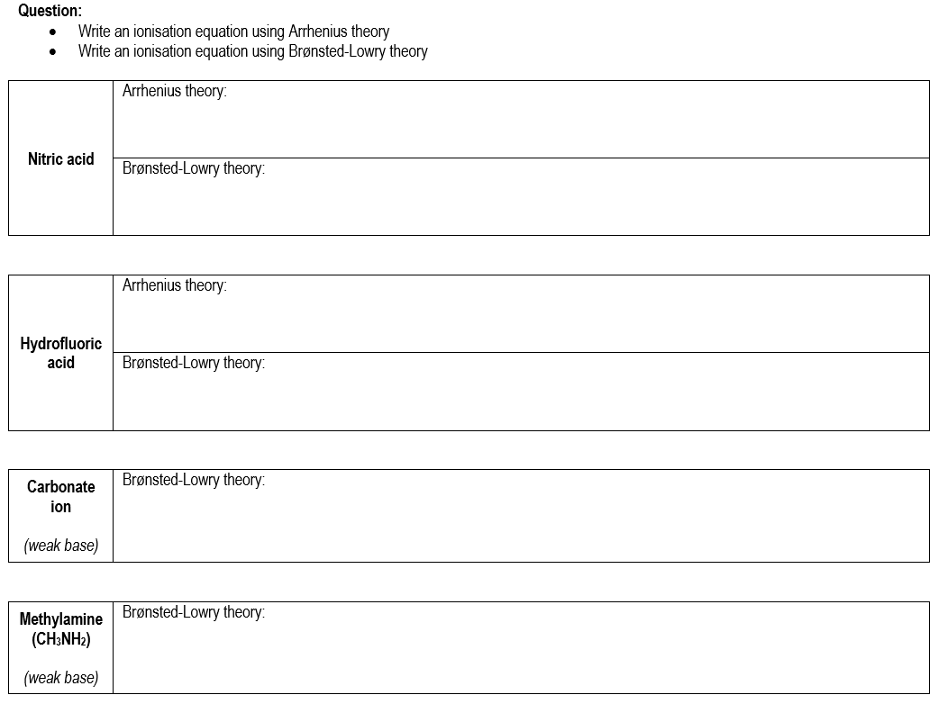

Slide 29
Brønsted-Lowry Theory
Identify the Brønsted-Lowry acids and bases. Show reasoning.
HSO₄⁻(aq) + HCO₃⁻(aq) → SO₄²⁻(aq) + H₂CO₃(aq)
C₆H₅O⁻(aq) + NH₃(aq) → C₆H₅OH(aq) + NH₂⁻(aq)

Slide 30
Conjugate acids and bases
Recall that ammonia is a weak base, hence its ionisation is a reversible reaction.
How would you classify:
Ammonia (NH₃)
Water (H₂O)
Ammonium (NH₄⁺)
Hydroxide (OH⁻)
-
H +
H
+
O
N
H
H
H

Slide 31
Conjugate acids and bases
Recall that ammonia is a weak base, hence its ionisation is a reversible reaction.
+
H
H
–
N
H
+
N
H
+
O
O
H
H
H
H
H
H
Base
(Accepts proton)
Acid
(Donates proton)
Acid
(Donates proton)
Base
(Accepts proton)

Slide 32
Conjugate acids and bases
Reaction between acetic acid and sodium carbonate:
How would you classify:
Ethanoic acid (CH₃COOH)
Carbonate ion (CO₃²⁻)
Ethanoate ion (CH₃COO⁻)
Hydrogencarbonate (HCO₃⁻)
2 –
–
H
H
O
+
O
C
C
H
C
O
H
O
O

Slide 33
Conjugate acids and bases
Reaction between acetic acid and sodium carbonate:
2–
H
–
–
H
H
O
H
O
+
O
C
C
H
+
O
C
C
H
C
C
O
O
O
H
O
O
O
H
Base
(Accepts proton)
Acid
(Donates proton)
Acid
(Donates proton)
Base
(Accepts proton)

Slide 34
Conjugate acids and bases
In a reversible reaction:
The species produced from a weak acid will be basic
The species produced from a weak base will be acidic
These groups are referred to as conjugate acid-base pairs
Conjugate pair #2
Base
Acid
HNO₂(aq) + H₂O(ℓ) ⇌ NO₂⁻(aq) + H₃O⁺(aq)
Acid
Base
Conjugate pair #2

Slide 35
Conjugate acids and bases
Conjugate pair #2
Base
Acid
HNO₂(aq) + H₂O(ℓ) ⇌ NO₂⁻(aq) + H₃O⁺(aq)
Acid
Base
Conjugate pair #2
For the above equation it can also be said that:
NO₂⁻ is the conjugate base of HNO₂ H₂O is the conjugate base of H₃O⁺
HNO₂ is the conjugate acid of NO₂⁻ H₃O⁺ is the conjugate acid of H₂O
An acid and its conjugate base will only differ in formula by one H⁺ ion.

Slide 36
Brønsted-Lowry Review Questions

Slide 37
Chemical equilibrium
Consider a solution of ethanoic acid in equilibrium:
CH₃COOH(aq) + H₂O(ℓ) ⇌ CH₃COO⁻(aq) + H₃O⁺(aq)
This solution would be in chemical equilibrium, therefore we can apply principles from the equilibrium topic.
While in equilibrium, the rate of forward and reverse reactions would be equal
While in equilibrium, the concentration of all species would remain constant
Changing the concentration of a species would affect equilibrium.
e.g. according to Le Châtelier’s Principle, removing H₃O⁺ would cause reaction to shift to the right

Slide 38
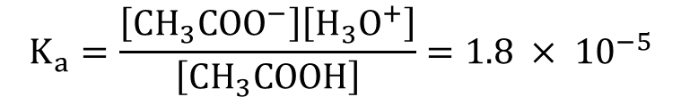

Chemical equilibrium
As with other systems, we can write equilibrium constant expressions to show the relative concentrations of species at equilibrium.
For the ionisation of an acid, this value is called the acid dissociation constant (K_{a}).
CH₃COOH(aq) + H₂O(ℓ) ⇌ CH₃COO⁻(aq) + H₃O⁺(aq)
HF(aq) + H₂O(ℓ) ⇌ F⁻(aq) + H₃O⁺(aq)
$$K_{a}=\frac{\left[{CH}_{3}{COO}^{−}\right]\left[H_{3}O^{+}\right]}{\left[{CH}_{3}COOH\right]}=1.8 × {10}^{−5}$$
Complete the expression →
$$K_{a}=\frac{ }{ }=7.2 × {10}^{−4}$$

Slide 39
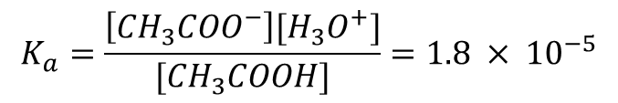
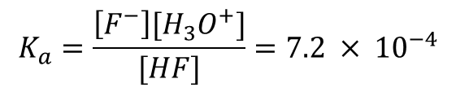
Equilibrium constants
$$K_{a}=\frac{\left[{{CH}_{3}COO}^{−}\right][{H_{3}O}^{+}]}{[{CH}_{3}COOH]}=1.8 × {10}^{−5}$$
CH₃COOH(aq) + H₂O(ℓ) ⇌ CH₃COO⁻(aq) + H₃O⁺(aq)
HF(aq) + H₂O(ℓ) ⇌ F⁻(aq) + H₃O⁺(aq)
Q: What does the size of the acid dissociation constant (K_{a}) for CH₃COOH indicate?
Q: What do the K_{a} vales of CH₃COOH and HF indicate about their relative strengths?
$$K_{a}=\frac{\left[F^{−}\right][{H_{3}O}^{+}]}{[HF]}=7.2 × {10}^{−4}$$

Slide 40
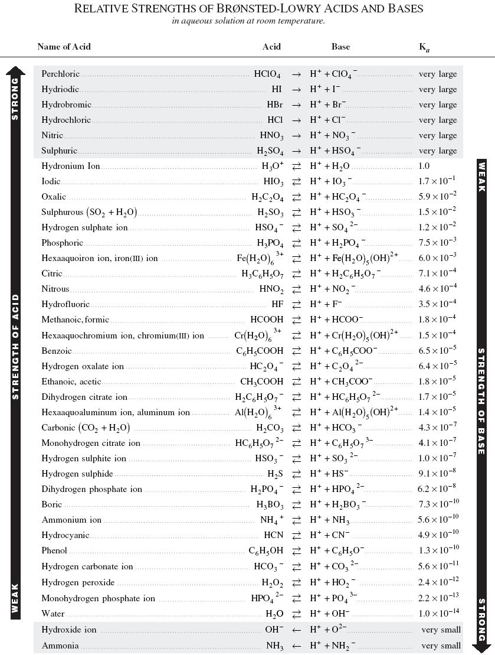

Slide 41
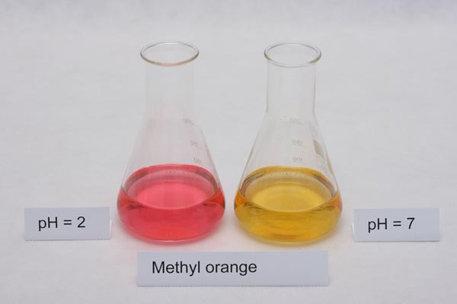
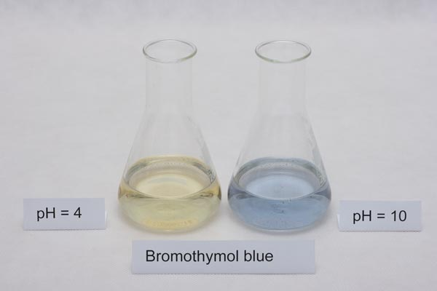
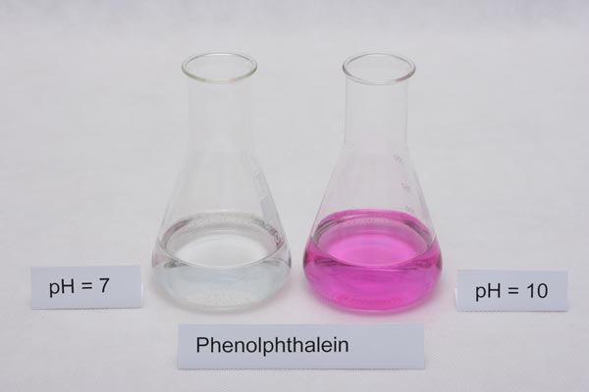
Indicators
Indicators are chemical species that change colour in different pH conditions. Most indicators are an acid-base conjugate pair, where each species in the pair is a different colour.

Slide 42
Indicators
General equation: HIn(aq) + H₂O(ℓ) ⇌ In⁻(aq) + H₃O⁺(aq)
colour 1 colour 2
In the above equation, “In” is used as shorthand for “indicator”. The indicator molecule can either be protonated (HIn) or de-protonated (In⁻).
Assume that there is initially an equal mix of HIn(aq) and In⁻(aq).
According the Le Châtelier’s principle, what would happen to the colour if…
HCℓ(aq) was added?
NaOH(aq) was added?

Slide 43
Indicators
Phenolphthalein: H-phph(aq) + H₂O(ℓ) ⇌ phph⁻(aq) + H₃O⁺(aq)
colourless bright pink/purple
Explain using Le Châtelier’s principle why phenolphthalein turns purple in solutions with pH >9.

Slide 44


Indicators
Methyl orange indicator:
+ H₃O⁺(aq) ⇌
+ H₂O(ℓ)
(Meor⁻)
(H-Meor)
Determine the colours of Meor⁻ and H-Meor. Justify your decision using Le Châtelier’s principle.

Slide 45
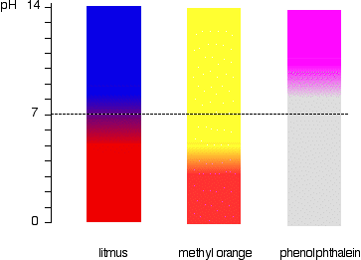
Indicators
Most indicators only have 2 or 3 different coloured forms. Indicators do not necessarily change at pH 7. Their changing point depends on the equilibrium constant for that indicator. Universal indicator is made of a mixture of four different types of indicator. This allows it to display a wide range of colours across the pH scale.

Slide 46
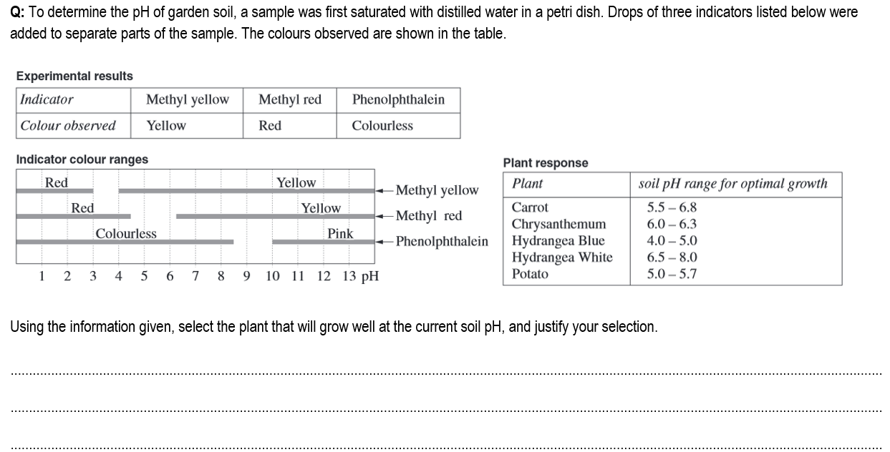

Slide 47
Salts from acid-base reactions
Salts are ionic compounds produced after the reaction of an acid and a base.
In general, the cation of the salt comes from the base and the anion comes from the acid.
Not all salts are neutral. Salts may be acidic or basic!
KOH(aq) + HNO₃(aq) → KNO₃(aq) + H₂O(ℓ)
salt

Slide 48
Acidic salts
Acidic salts contain an ion which is a proton donor.
Example: Ammonium chloride is an acidic salt because ammonium ion (NH₄⁺) is a proton donor.
When dissolved in water, the NH₄⁺ ion undergoes a hydrolysis reaction. It donates a proton to water molecules to form H₃O⁺.
NH₄⁺(aq) + H₂O(ℓ) ⇌ NH₃(aq) + H₃O⁺(aq)
This increase the [H₃O⁺] relative to [OH⁻], therefore decreases the pH of the solution.

Slide 49
Basic salts
Basic salts contain an ion which is a proton acceptor.
Example: Sodium acetate is a basic salt because acetate ion (CH₃COO⁻) is a proton acceptor.
When dissolved in water, the CH₃COO⁻ ion undergoes a hydrolysis reaction. It accepts a proton to water molecules to form OH⁻.
CH₃COO⁻(aq) + H₂O(ℓ) ⇌ CH₃COOH(aq) + OH⁻(aq)
This increase the [OH⁻] relative to [H₃O⁺] , therefore increases the pH of the solution.

Slide 50
Neutral salts
Neutral salts do not contain protons acceptors or donors.
Example: Sodium chloride is a neutral salt.
Neither ion undergoes hydrolysis with water to accept or donate protons.
**BE CAREFUL** Some students incorrectly assume Cℓ⁻ could accept protons to form HCℓ
This isn’t true because HCℓ is a strong acid. HCℓ + H₂O → Cℓ⁻ + H₃O⁺
If Cℓ- could accept protons to form HCℓ then the above would be a reversible reaction and HCℓ would be a weak acid

Slide 51
Shortcut…
You may have noticed a pattern…
Basic salts (e.g. NaCH₃COO) contain an ion from a weak acid
Acidic salts (e.g. NH₄Cℓ) contain an ion from a weak base
Neutral salts (e.g. NaOH) contain ions from strong acids and bases
This can be used as a shortcut to quickly figure out if a salt is acidic, basic or neutral.
But it is not an explanation.
If it asks ‘why is sodium acetate a basic salt’ you can’t say ‘because acetic acid is a weak acid’. You would have to talk about the acetate ion accepting a proton, give the equation and state how it affects the [H₃O⁺] and [OH⁻] in solution.

Slide 52
Salts from polyprotic acids
If is salt is produced from a polyprotic acid, then the resulting salt might be acidic or basic, depending on which acid is involved.
Consider the salt sodium hydrogencarbonate (NaHCO₃). When dissolved in water, it will first dissociate and then the HCO₃⁻ can react with water. But it can do so in two different ways…
HCO₃⁻(aq) + H₂O(ℓ) ⇌ CO₃²⁻(aq) + H₃O⁺(aq) If HCO₃⁻ loses a proton then the resulting solution is acidic
or
HCO₃⁻(aq) + H₂O(ℓ) ⇌ H₂CO₃(aq) + OH⁻(aq) If HCO₃⁻ gains a proton then the resulting solution is basic

Slide 53
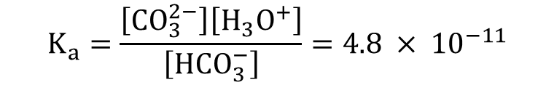
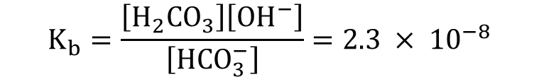
Salts from polyprotic acids
HCO₃⁻(aq) + H₂O(ℓ) ⇌ CO₃²⁻(aq) + H₃O⁺(aq) If HCO₃⁻ loses a proton then the resulting solution is acidic
or
HCO₃⁻(aq) + H₂O(ℓ) ⇌ H₂CO₃(aq) + OH⁻(aq) If HCO₃⁻ gains a proton then the resulting solution is basic
The final pH of the solution depends on which of the above reactions occurs to the greatest extent. This could be compared using equilibrium constants.
Based on the K_{a} and K_{b} values, would the HCO₃⁻ form an acidic or basic solution? Explain.
$$K_{a}=\frac{\left[{CO}_{3}^{2−}\right]\left[H_{3}O^{+}\right]}{\left[{HCO}_{3}^{−}\right]}=4.8 × {10}^{−11}$$
$$K_{b}=\frac{\left[H_{2}{CO}_{3}\right]\left[{OH}^{−}\right]}{\left[{HCO}_{3}^{−}\right]}=2.3 × {10}^{−8}$$

Slide 54
Salts from polyprotic acids
Unless provided with K_{a} and K_{b} values in a test, there is no way to determine whether an ion like HCO₃⁻ would form an acidic or basic solution.
That means that you will have to memorise the following table so you can correctly remember which salts from polyprotic acids are acidic, basic and neutral.
Related acid | Acidic ions (will donate proton and form H₃O⁺) | Basic ions (will accept proton and form OH⁻)
Sulfuric acid | HSO₄⁻ | SO₄²⁻
Carbonic acid |  | HCO₃⁻ CO₃²⁻
Phosphoric acid | H₂PO₄⁻ | HPO₄²⁻ PO₄³⁻
Salts from the first ionisation of sulfuric and phosphoric are acidic
If you can’t remember in a test, guess basic

Slide 55
(Questions from next page)

Slide 56
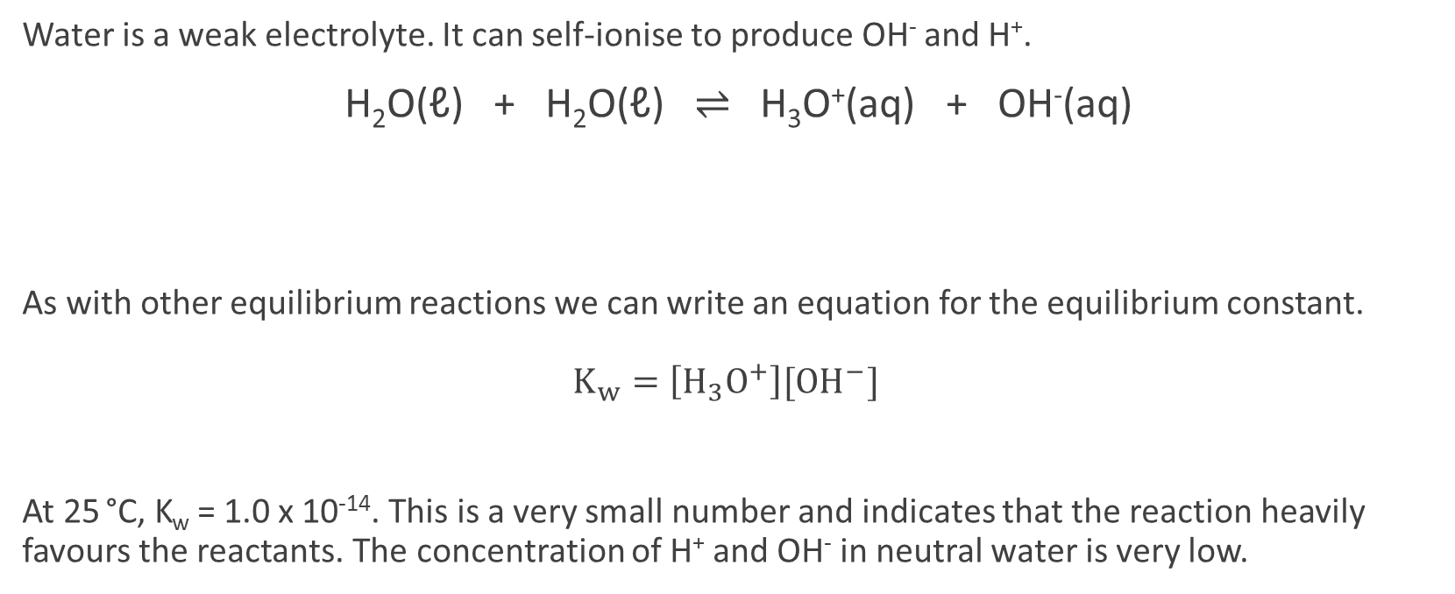
Water as an electrolyte
Water is a weak electrolyte. It can self-ionise to produce OH⁻ and H⁺.
H₂O(ℓ) + H₂O(ℓ) ⇌ H₃O⁺(aq) + OH⁻(aq)
As with other equilibrium reactions we can write an equation for the equilibrium constant. $K_{w}=\left[H_{3}O^{+}\right][{OH}^{−}]$
At 25 °C, K_{w} = 1.0 x 10⁻¹⁴. This is a very small number and indicates that the reaction heavily favours the reactants. The concentration of H⁺ and OH⁻ in neutral water is very low.
Base
Gains a proton
Acid
Loses a proton

Slide 57


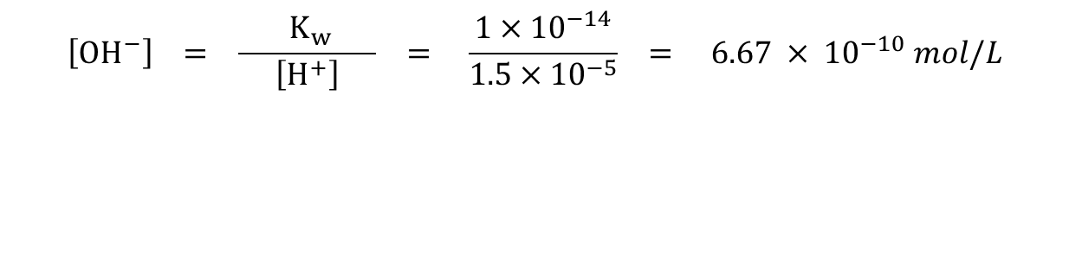
Calculating [H⁺] and [OH⁻]
Note: In these calculations, H⁺ and H₃O⁺ can be used interchangeably. H⁺ (from Arrhenius theory) is usually shown in calculations because it is faster and easier than writing H₃O⁺.
If we know [H⁺] in a solution, then we can calculate [OH⁻] using the value of K_{w}.
e.g. A solution of acid contains 1.5 x 10⁻⁵ mol L⁻¹ of H⁺. Calculate [OH⁻].
$${ K}_{w}=\left[H^{+}\right]\left[{OH}^{−}\right] \\ ∴\left[{OH}^{−}\right]=\frac{{ K}_{w} }{\left[H^{+}\right]}=\frac{1×{10}^{−14}}{\left[H^{+}\right]}$$
$$\left[{OH}^{−}\right] = \frac{{ K}_{w} }{\left[H^{+}\right]} = \frac{1×{10}^{−14}}{1.5×{10}^{−5}} = 6.67 × {10}^{−10} mol/L$$

Slide 58

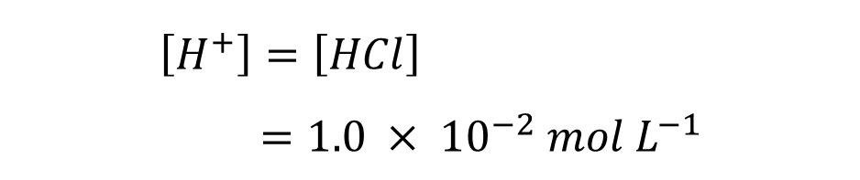
Calculating [H⁺] and [OH⁻]
Example: Calculate the concentration of H⁺ and OH⁻ in a 1.0 x 10⁻² mol L⁻¹ HCℓ solution at 25 °C.
HCℓ(g) → H⁺(aq) + Cℓ⁻(aq)
$${ K}_{w}=\left[H^{+}\right]\left[{OH}^{−}\right] \\ \left[{OH}^{−}\right]=\frac{K_{w}}{\left[H^{+}\right]} \\ =\frac{1.0 × {10}^{−14}}{1.0 × {10}^{−2}} \\ =1.0 × {10}^{−12} mol L^{−1}$$
$$\left[H^{+}\right]=\left[HCl\right] \\ =1.0 × {10}^{−2} mol L^{−1}$$

Slide 59

Calculating [H⁺] and [OH⁻]
Note that we can also rearrange the K_{w} equation to find [H⁺] if we know [OH⁻].
Complete questions on opposite page of workbook.
$${ K}_{w}=\left[H^{+}\right]\left[{OH}^{−}\right] \\ ∴\left[H^{+}\right]=\frac{{ K}_{w} }{\left[{OH}^{−}\right]}=\frac{1×{10}^{−14}}{\left[{OH}^{−}\right]}$$

Slide 60
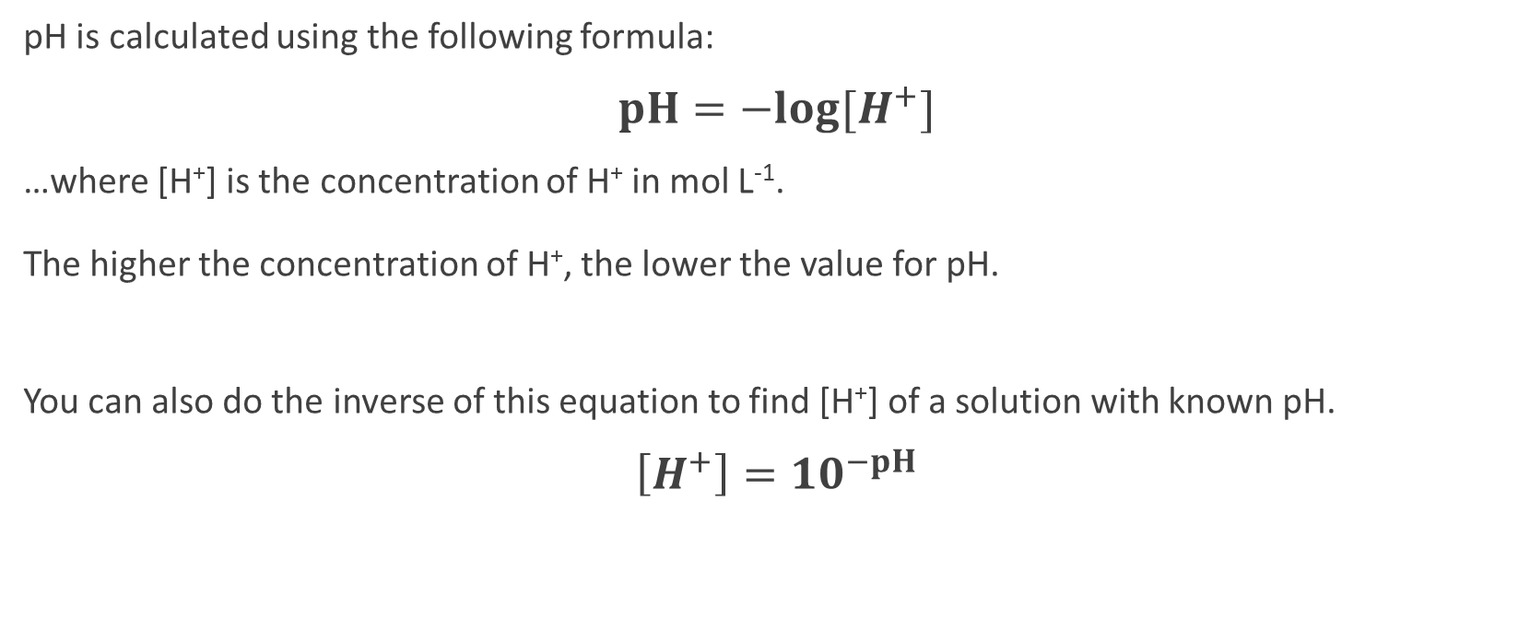
pH scale
pH is calculated using the following formula:
$pH=−log⁡[H^{+}]$
…where [H⁺] is the concentration of H⁺ in mol L⁻¹. The higher the concentration of H⁺, the lower the value for pH.
You can also do the inverse of this equation to find [H⁺] of a solution with known pH.
$\left[H^{+}\right]={10}^{−pH}$

Slide 61

Calculating pH – Strong acids
To calculate the pH of a strong acid solution…
1. Find [H⁺]
2. Perform the pH calculation
e.g. Calculate the pH of a 0.06 mol L⁻¹ solution of HCℓ.
$\left[H^{+}\right]=\left[HCl\right]=0.06 mol L^{−1}$
$pH=−\log\left[H^{+}\right]$ $=−\log\left[0.06\right]$ $=1.22$

Slide 62
Calculating pH – Strong acids
Q: Calculate the pH of a 5.0 x 10⁻³ mol L⁻¹ solution of HNO₃
Q: 2 litres of hydrogen chloride gas (HCℓ) is collected at S.T.P. and is dissolved in 500 L of water. Calculate the pH of the resulting solution.

Slide 63
Calculating pH – Strong bases
There are two ways to go about this. Both methods rely on the fact that [OH⁻] and [H⁺] are linked. Remember, K_{w} = [H⁺][OH⁻]
Method 1 (longer):
1. Find [OH⁻]
2. Find [H⁺] using the relationship with K_{w}. [H⁺] = K_{w} / [OH⁻]
3. Find pH using the formula pH = -log[H⁺]

Slide 64

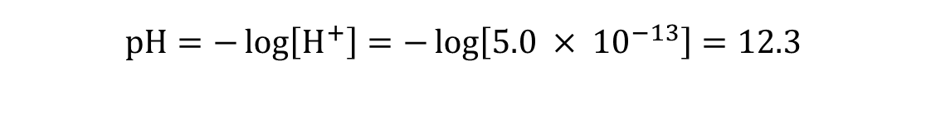

Calculating pH – Strong bases
Example (Method 1): Calculate the pH of a 2.0 x 10⁻² mol L⁻¹ NaOH solution.
NaOH → Na⁺ + OH⁻
$$\left[H^{+}\right]=\frac{K_{w}}{\left[{OH}^{−}\right]} \\ =\frac{1.0 × {10}^{−14}}{2.0 × {10}^{−2}} \\ =5.0 × {10}^{−13} mol L^{−1}$$
2
$$\left[{OH}^{−}\right]=\left[NaOH\right] \\ =2.0 × {10}^{−2} mol L^{−1}$$
1
3
$$pH=−\log\left[H^{+}\right]=−\log\left[5.0 × {10}^{−13}\right]=12.3$$

Slide 65
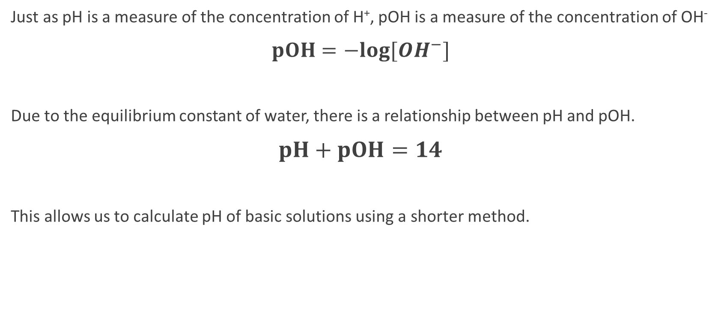
Calculating pH – Strong bases
Just as pH is a measure of the concentration of H⁺, pOH is a measure of the concentration of OH⁻
$pOH=−log⁡[{OH}^{−}]$
Due to the equilibrium constant of water, there is a relationship between pH and pOH.
$pH+pOH=14$
This allows us to calculate pH of basic solutions using a shorter method.

Slide 66
Calculating pH – Strong bases
Method 2 (shorter):
1. Find [OH⁻]
2. Find pOH using the formula pOH = -log[OH⁻]
3. Find pH using the formula pH = 14 – pOH

Slide 67
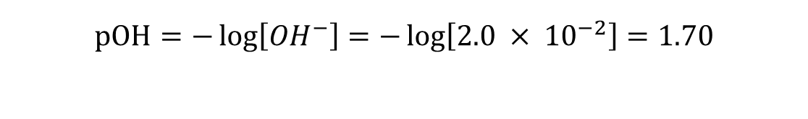

Calculating pH – Strong bases
Example (Method 2): Calculate the pH of a 2.0 x 10⁻² mol L⁻¹ NaOH solution.
NaOH → Na⁺ + OH⁻
$$\left[{OH}^{−}\right]=\left[NaOH\right] \\ =2.0 × {10}^{−2} mol L^{−1}$$
1
2
$$pOH=−\log\left[{OH}^{−}\right]=−\log\left[2.0 × {10}^{−2}\right]=1.70$$
$$pH=14 −pOH=14 −1.70=12.3$$
3

Slide 68
Calculating pH – Mixing two acids
Some problems might involve two acidic solutions with different pH values being mixed together.
To solve:
1. Find n(H⁺) in the first solution n(H⁺)₁
2. Find n(H⁺) in the second solution n(H⁺)₂
3. Find the total n(H⁺) ions n(H⁺)_{total} = n(H⁺)₁ + n(H⁺)₂
4. Find the concentration of the total n(H⁺). Remember to use the volume of the total solution
5. Calculate pH as per previous pages

Slide 69
Calculating pH – Mixing two acids
Example: 100 mL of 0.005 mol L⁻¹ HCℓ is added to 200 mL of 0.0001 mol L⁻¹ HCℓ
Total volume = 300 mL = 0.3 L
c(H⁺)_{total} = n / V
= 0.0007 / 0.300
= 0.002333 mol L⁻¹
1
n(H⁺)₁ = c x V
= 0.005 x 0.100
= 0.0005 mol
4
2
n(H⁺)₂ = c x V
= 0.0001 x 0.200
= 0.0002 mol
pH = -log[H⁺]
= -log[0.002333]
= 2.63
5
3
n(H⁺)_{total} = n(H⁺)₁ + n(H⁺)₂
= 0.0005 + 0.0002
= 0.0007 mol

Slide 70
Calculating pH – Mixing two bases
Perform this calculation in the same way as mixing two acids, only now you will be finding n(OH⁻).
To solve:
1. Find n(OH⁻) in the first solution n(OH⁻)₁
2. Find n(OH⁻) in the second solution n(OH⁻)₂
3. Find the total n(OH⁻) ions n(OH⁻)_{total} = n(OH⁻)₁ + n(OH⁻)₂
4. Find the concentration of the total n(OH⁻). Remember to use the volume of the total solution
5. Calculate pH as per previous pages

Slide 71
Calculating pH – Mixing acid + base
Sometimes you may have a question where a strong acid is mixed with a strong base. Acids and bases neutralise each other…
H⁺ + OH⁻ → H₂O
…but if excess acid is used then the resulting solution will be acidic, and if excess base is used then the resulting solution will be basic.
You may need to calculate the pH of such a solution after the acid and base have been mixed together.

Slide 72
Calculating pH – Mixing acid + base
Method:
1. Find n(H⁺)
2. Find n(OH⁻)
3. Figure out which substance is in excess. Calculate n(H⁺ excess) or n(OH⁻ excess)
4. Find the concentration of the excess ions. Remember to use the volume of the total solution
5. Calculate pH as per previous pages

Slide 73
Calculating pH – Mixing acid + base
Example: 100 mL of 1 mol L⁻¹ Ca(OH)₂ is added to 400 mL of 0.300 mol L⁻¹ HCℓ. What is the pH of the new solution?
pOH = -log[OH⁻]
= -log[0.16]
= 0.796
pH = 14 – pOH
= 13.2
1
n(Ca(OH)₂) = c x V
= 1 x 0.1
= 0.1 mol
n(OH⁻) = 2 x n(Ca(OH)₂)
= 0.2 mol
3
H⁺ + OH⁻ → H₂O
n(OH⁻ excess) = n(OH⁻) - n(H⁺)
= 0.200 – 0.120
= 0.080 mol
5
Total volume = 500 mL = 0.5 L
c(OH⁻ excess) = n / V
= 0.080 / 0.500
= 0.16 mol L⁻¹
4
n(HCℓ) = c x V
= 0.300 x 0.400
= 0.120 mol
n(H⁺) = 0.120 mol
2

Slide 74
Acidic, Basic & Neutral
A neutral solution is defined as a solution with equal concentrations of H⁺ and OH⁻.
Even though pure water self-ionises to produce small amounts of [H⁺] and [OH⁻], the resulting solution will still be neutral because [H⁺] = [OH⁻]
H₂O ⇌ H⁺ + OH⁻
Acidic
Neutral
Basic
[H⁺] > [OH⁻]
[H⁺] = [OH⁻]
[H⁺] < [OH⁻]

Slide 75
pH of Neutral Solutions
We can calculate the pH of neutral water at 25 °C by combining two equations:
Equation 1: [H⁺] = [OH⁻] This equation is true for any neutral solution
Equation 2: K_{w} = [H⁺] [OH⁻] Equilibrium constant for water.
1 x 10⁻¹⁴ = [H⁺] [OH⁻] This is the value of K_{w} at 25 °C

Slide 76

pH of Neutral Solutions
Example: Show using calculations that the pH of neutral water at 25 ºC is equal to 7.
$$K_{w}=\left[H^{+}\right]\left[{OH}^{−}\right] The solution is neutral, ∴\left[H^{+}\right]= \left[{OH}^{−}\right] \\ ={\left[H^{+}\right]}^{2} At 25 ℃,K_{w}=1.0 ×{10}^{−14} \\ 1.0 ×{10}^{−14}={\left[H^{+}\right]}^{2} \\ \left[H^{+}\right]=\sqrt{1.0 ×{10}^{−14}} \\ =1 × {10}^{−7}$$
$$pH=−log\left[H^{+}\right]$$ $=−\log\left[1 × {10}^{−7}\right]$
$$=7.00$$

Slide 77
Effect of temperature of pH
Like all equilibrium reactions, the self-ionisation of water is affected by temperature.
Investigate the table to the right. Is the self-ionisation of water an exothermic or endothermic process? Explain your answer in terms of Le Châtelier’s principle.
Temperature (°C) | K_{w}
0 | 0.11 x 10⁻¹⁴
10 | 0.29 x 10⁻¹⁴
20 | 0.68 x 10⁻¹⁴
25 | 1.01 x 10⁻¹⁴
30 | 1.47 x 10⁻¹⁴
40 | 2.92 x 10⁻¹⁴
50 | 5.48 x 10⁻¹⁴
100 | 51.3 x 10⁻¹⁴

Slide 78
Effect of temperature of pH
You should be able to calculate the pH of neutral water at any temperature if given the value of K_{w}.
The working will be similar to that on the previous page
Q: Calculate the pH of water at the following temperatures. Use the K_{w} values from the table above.
Neutral water at 10 ºC
Neutral water at 50 ºC

Slide 79
Buffers
Buffers are solutions that resists changes to pH.
They are made of a weak acid and its conjugate base. Examples:
A mixture of acetic acid (CH₃COOH) and sodium acetate (NaCH₃COO)
A mixture of ammonia (NH₃) and ammonium chloride (NH₄Cl)
A mixture of phosphoric acid (H₃PO₄) and sodium phosphate (Na₃PO₄)

Slide 80
How buffers work
Consider a solution containing acetic acid and sodium acetate.
Inside the solution, the acetic acid and acetate would be in equilibrium.
CH₃COOH + H₂O ⇌ CH₃COO⁻ + H₃O⁺
Explain why pH would remain roughly constant when adding acid:
When acid is added this would initially increase [H₃O⁺]
According to Le Châtelier’s Principle the system will react to oppose this change.
The reaction will shift to the left, decreasing [H₃O⁺] close to its original value
As [H₃O⁺] does not change greatly, there is little change to pH

Slide 81
How buffers work
Consider a solution containing acetic acid and sodium acetate.
Inside the solution, the acetic acid and acetate would be in equilibrium.
CH₃COOH + H₂O ⇌ CH₃COO⁻ + H₃O⁺
Explain why pH would remain roughly constant when adding base:
When base is added this would initially decrease [H₃O⁺]
According to Le Châtelier’s Principle the system will react to oppose this change.
The reaction will shift to the right, increasing [H₃O⁺] close to its original value
As [H₃O⁺] does not change greatly, there is little change to pH

Slide 82
Buffering capacity
Buffering capacity is a measure of how well a buffer can resist changes to pH.
A buffer with a high buffering capacity can have a lot of acid and base added before pH changes
A buffer with a low buffering capacity can only prevent changes for a small amount of acid or base.
Two factors affect buffering capacity:
The relative amounts of the weak acid and its conjugate base. Buffers work best with equimolar amounts. e.g. 0.5 mol CH₃COOH + 0.5 mol CH₃COO⁻ _{c.f. 0.5 mol + 0.1 mol}
The overall concentration of the buffer High concentration of buffers are better. e.g. 2 mol CH₃COOH + 2 mol CH₃COO⁻ _{c.f. 0.5 mol + 0.5 mol}

Slide 83
Pure water
Pure water has extremely low buffering capacity.
Pure water does have H₃O+ and OH- ions due to the self-ionisation of water.
Adding

Slide 84
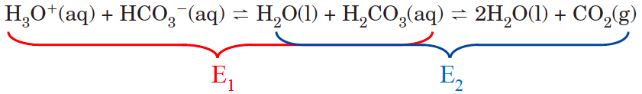
Applications of buffers
Blood:
Cells need to maintain a relatively constant pH in order for enzymes to function correctly.
The pH of blood maintains a pH between 7.35 and 7.45. This pH is maintained through a number of chemical buffers. One is an equilibrium system involving hydrogencarbonate ions, carbonic acid and CO₂(g).

Slide 85
